Slide 1
Mondegreens
Madison couture

Slide 2
The Definition: A mondegreen is when a word or phrase in a song is misunderstood resulting in misinterpreted lyrics.

Slide 3
Hey Way- PARTYNEXTDOOR
I still say, these b***hes like greasy loafers
She gets down just like Lindsay Lohan
Round applause, she’s not going shopping
That b***h bad, watch her blow up all night
I'll still say, this b***h looks like Lindsay Lohan (Lindsay Lohan) She gets down just like Lindsay Lohan (yeah, yeah, yeah) Round the block, she's not showin' nothin' That b***h bad, watch her blow a whole band
0:25 – 0.42
https://www.youtube.com/watch?v=1Eops1caFVM

Slide 4
Cover Me Up- Morgan Wallen
The days we were raised, we flew off the pave
Sub sad he was numb
The days when we raged, we flew off the page Such damage was done
0:23 – 0:44
https://www.youtube.com/watch?v=1RnChOf8RTs

Slide 5
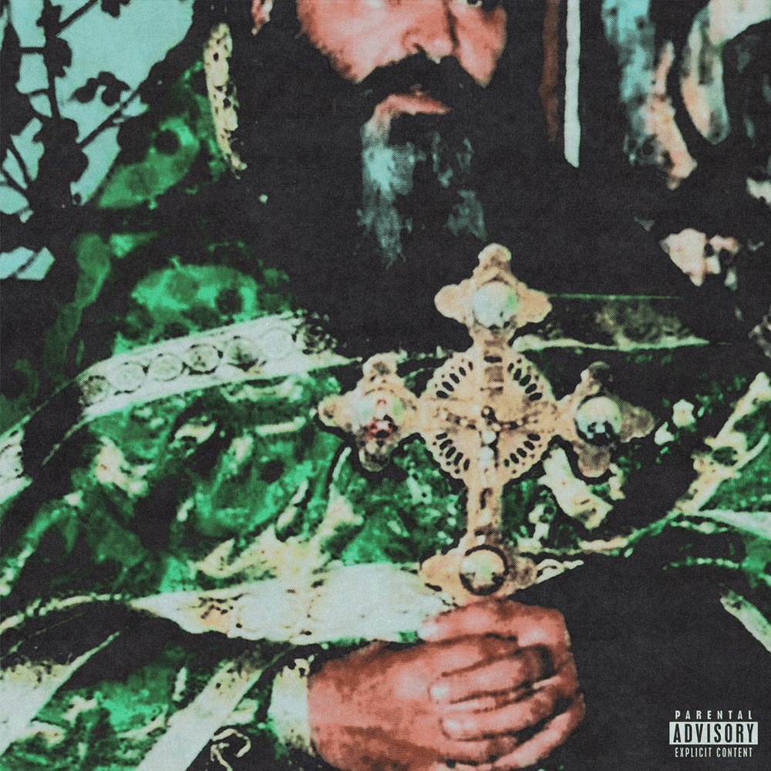
1000 Blunts- $uicideboy$
Haunted, Haunted, i know its in my mind, I know its in my mind
Haunted, haunted
Hold tight, (you did good, $lick) hold tight (it's a Smash) I know this in my mind, I know this in my mind Hold tight, hold tight
0:00 – 0:09
https://www.youtube.com/watch?v=VgjTx7RVJPI

Slide 6
Spin Bout U- Drake ft 21 savage
Burn somebody's body for you
Burn somebody block for you
2:55 – 2:57
https://www.youtube.com/watch?v=jALeORvCJG8

